Slide 1
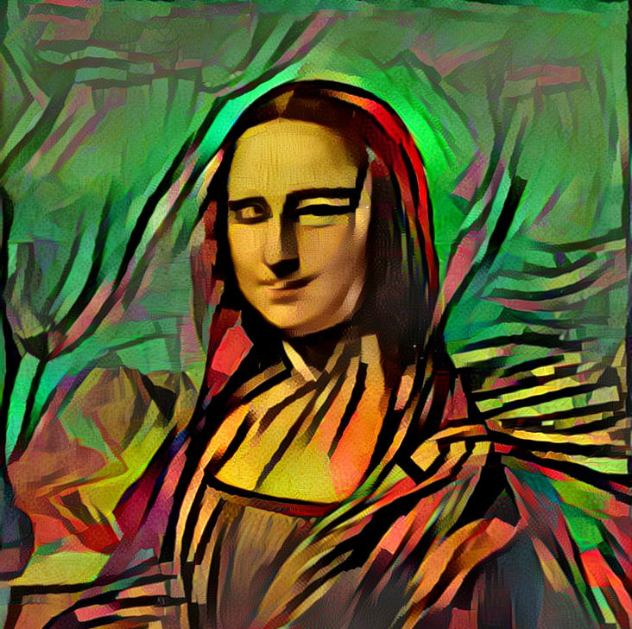
Image Style Transfer Using Convolutional Neural Networks
This Photo by Unknown author is licensed under CC BY.

Slide 2
A Neural Algorithm of Artistic Style
NST was first published in the paper "A Neural Algorithm of Artistic Style" by Leon Gatys in 2015
The original paper used a VGG-19 architecture that has been pre-trained to perform object recognition using the ImageNet dataset.
n 2017, Google AI introduced a method^{[6]} that allows a single deep convolutional style transfer network to learn multiple styles at the same time. This algorithm permits style interpolation in real-time, even when done on video media.

Slide 3
Deep image representations
Content representation
Style representati

Slide 4
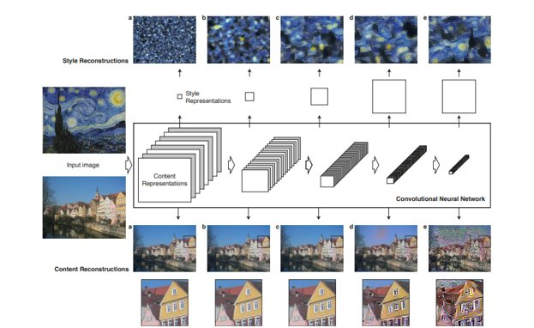

Slide 5
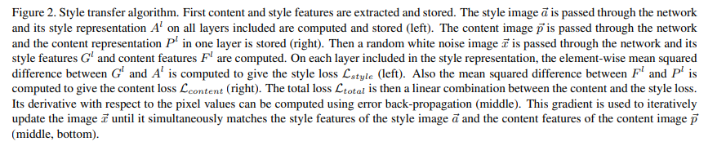
Style transfer

Slide 6
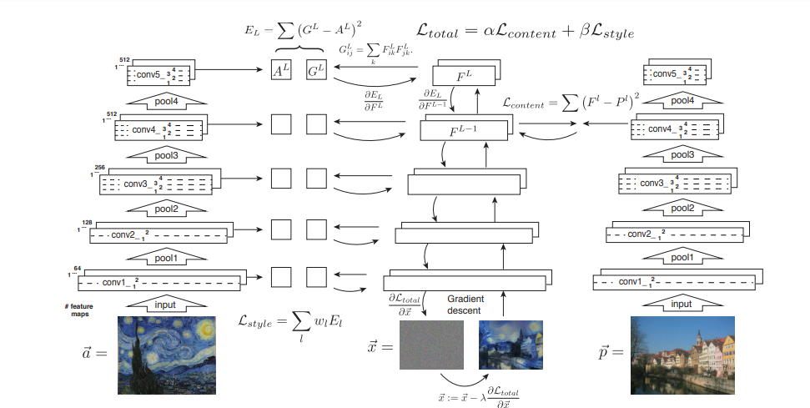

Slide 7
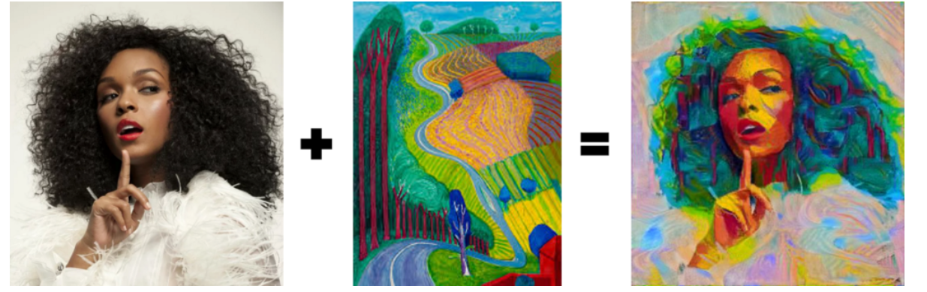
Examples

Slide 8
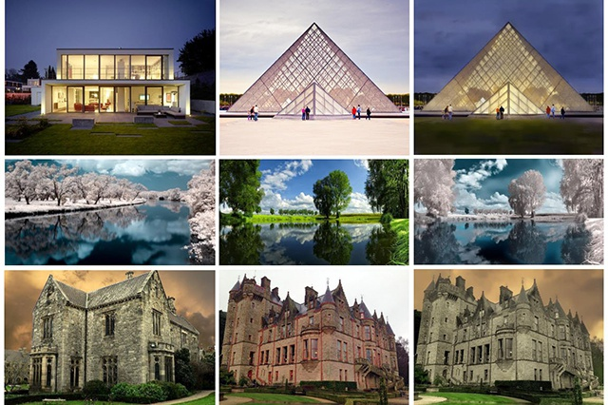

Slide 9
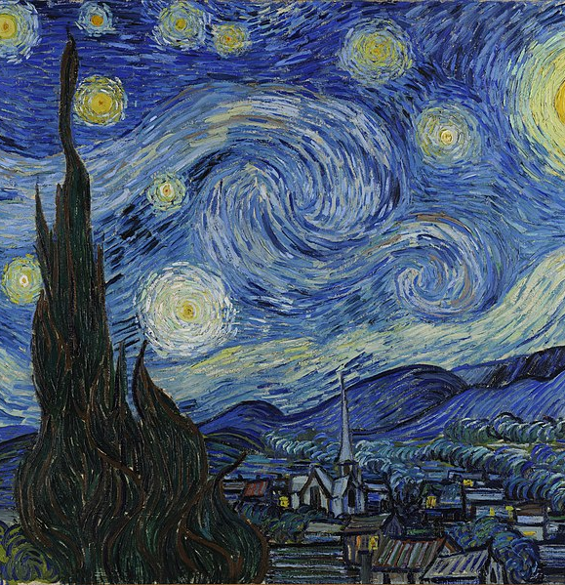

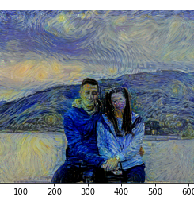
MY results

Slide 10


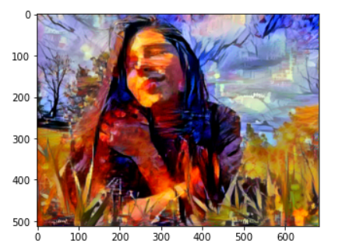

Slide 11
Thanks
By. Bacso Amalia Angela

